Slide 1

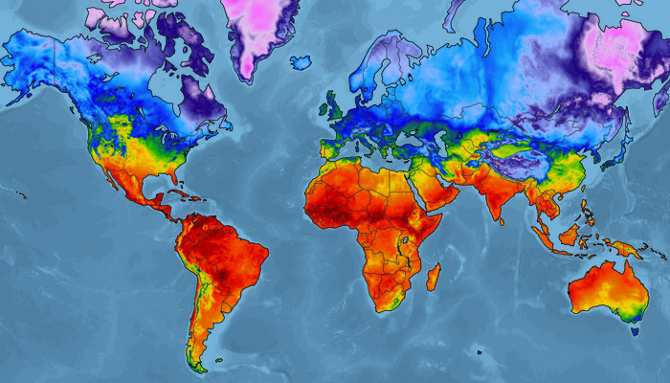
ANLY 565- TIME SERIES
GLOBAL TEMPERATURE
FORECASTING
Pruthak Patel, Rumana Myageri, Zhimu Wang

Slide 2
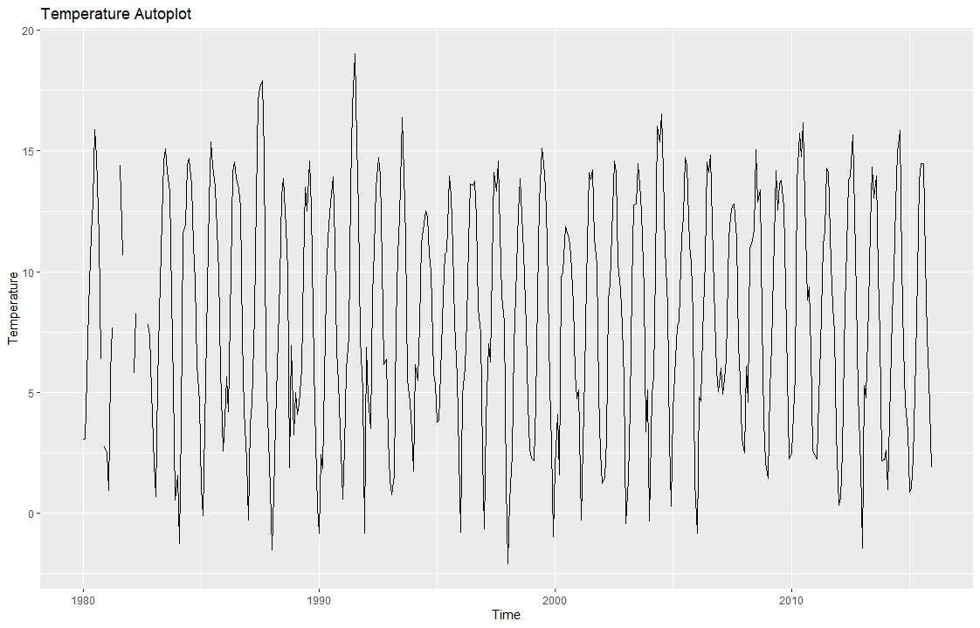
Introduction
A study of earth surface temperature data in R to forecast global temperature using Time Series Analysis and different models.
Data
The dataset consists of global temperatures from the year 1980 to 2015.

Slide 3
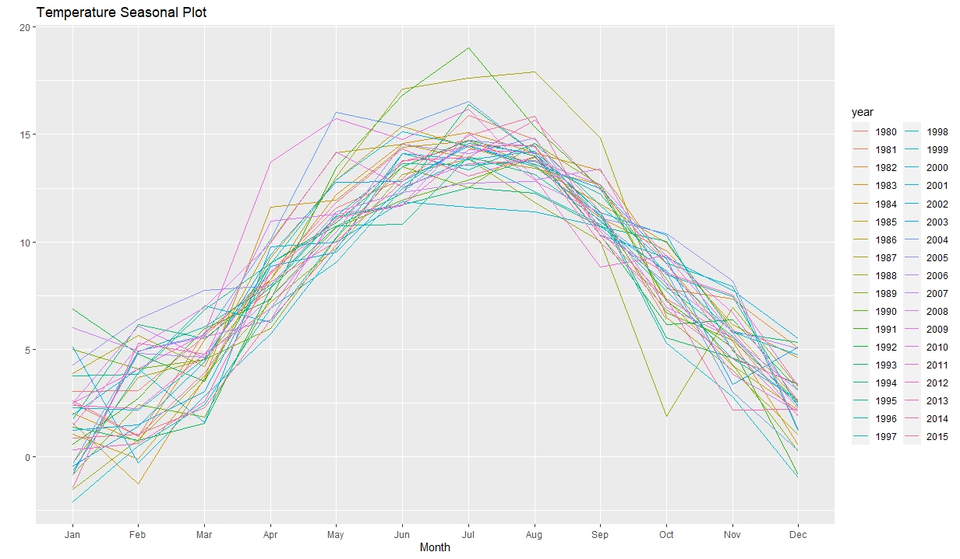
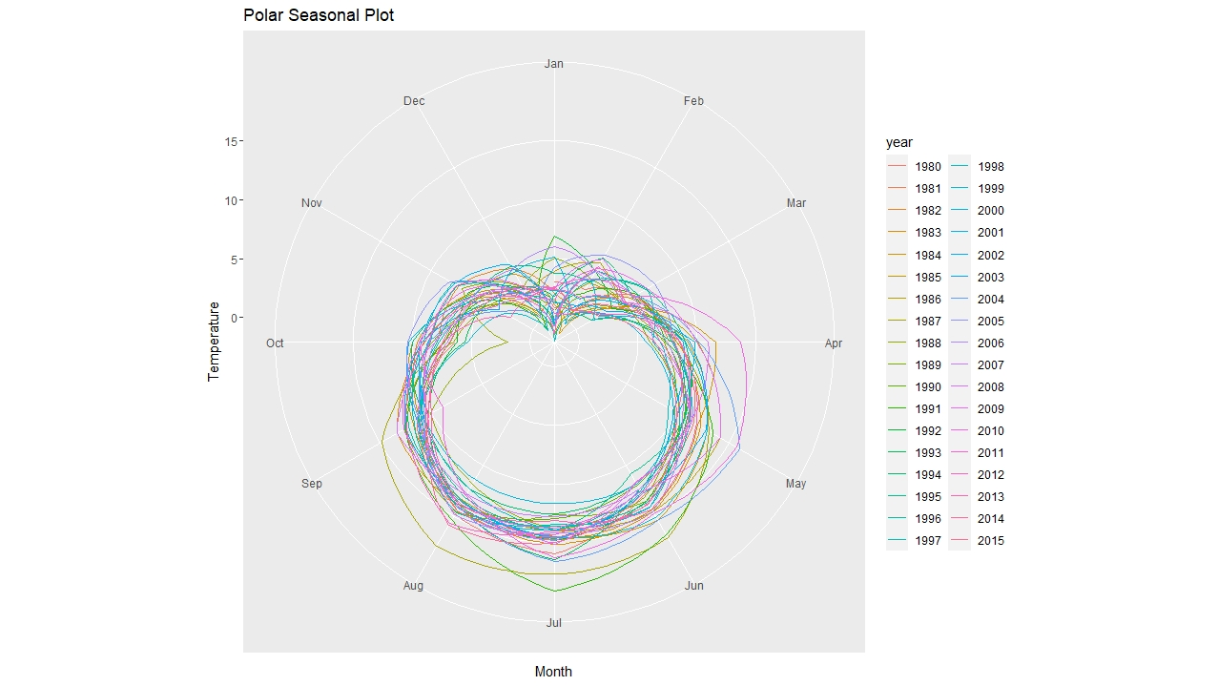
Seasonal Plots
It’s clear that Avg temperature rises slowly from January and attains peak at June, July, after which it falls.
Time Series plots display both seasonal and cyclic patterns.

Slide 4
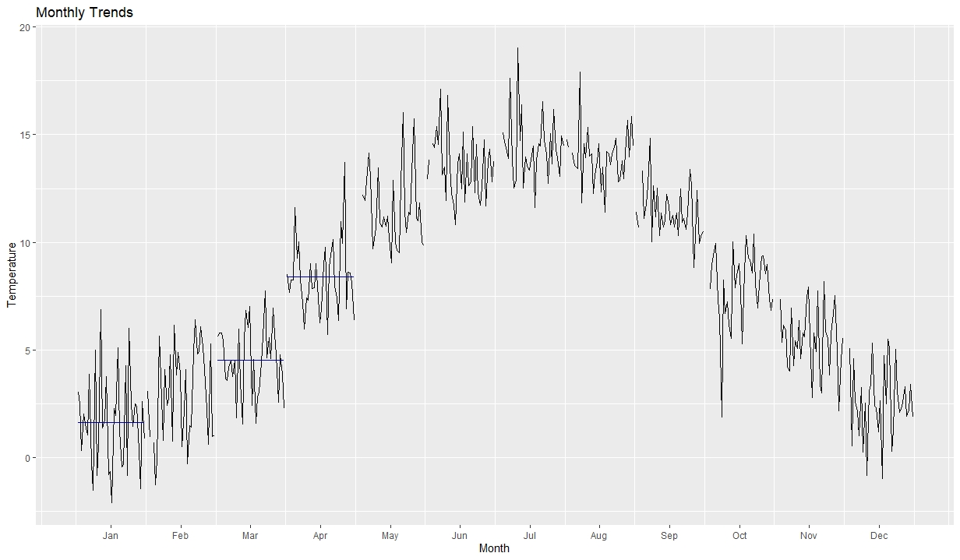
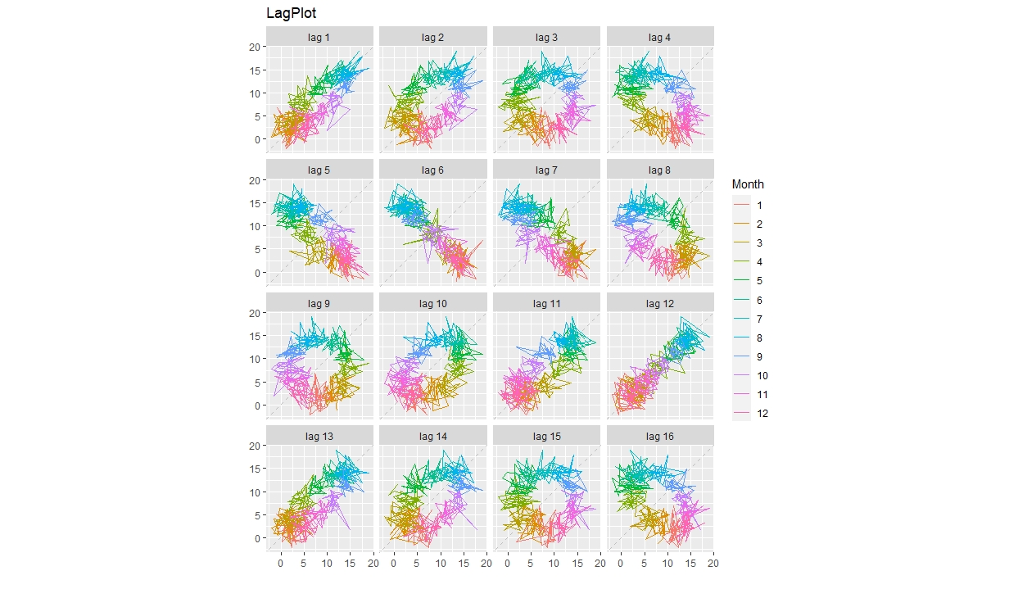
Monthly Trends
Monthly trends display distinct seasonal patterns

Slide 5
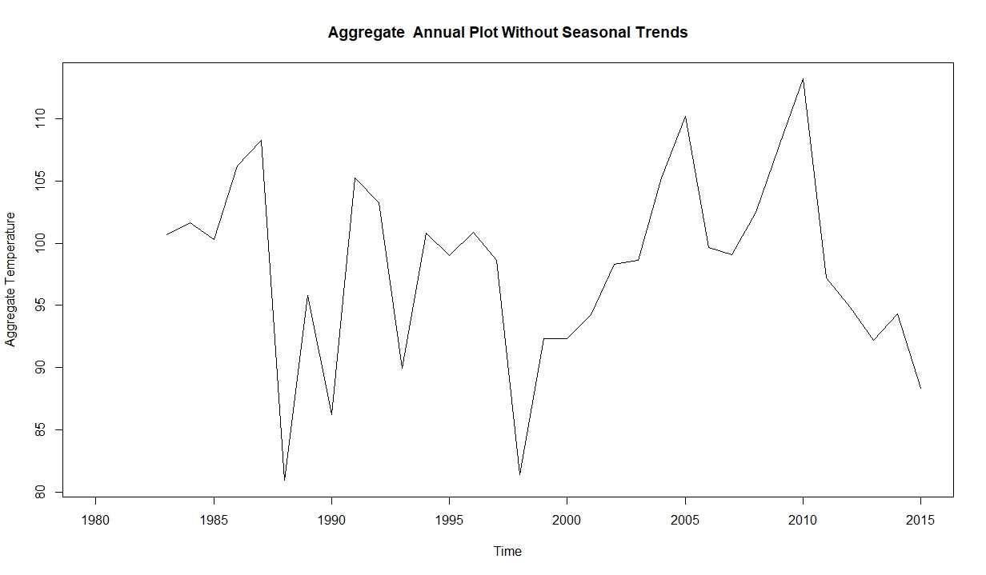
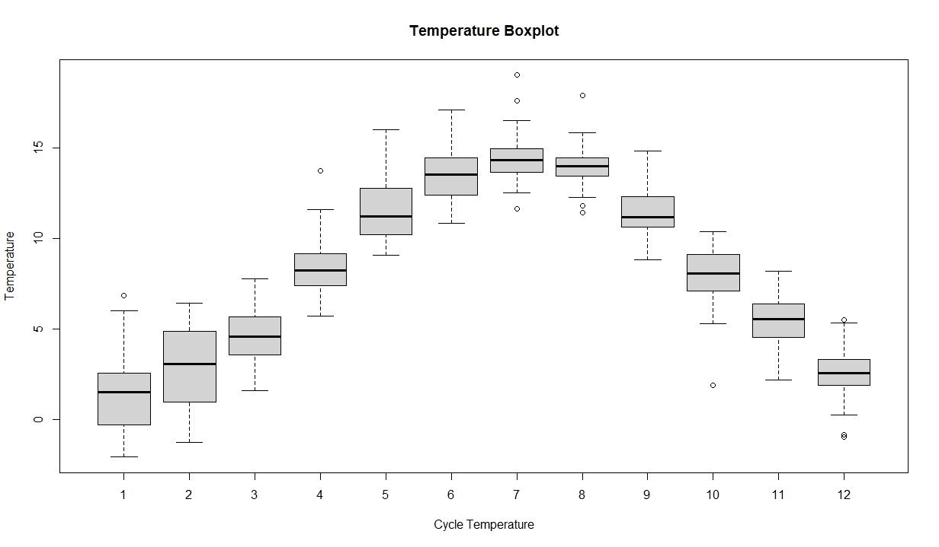
Annual Plots
Aggregate Temperature annual plot
Monthly temperature boxplots
It’s clear that Avg temperature rises slowly from January and attains peak at June, July, after which it falls.

Slide 6
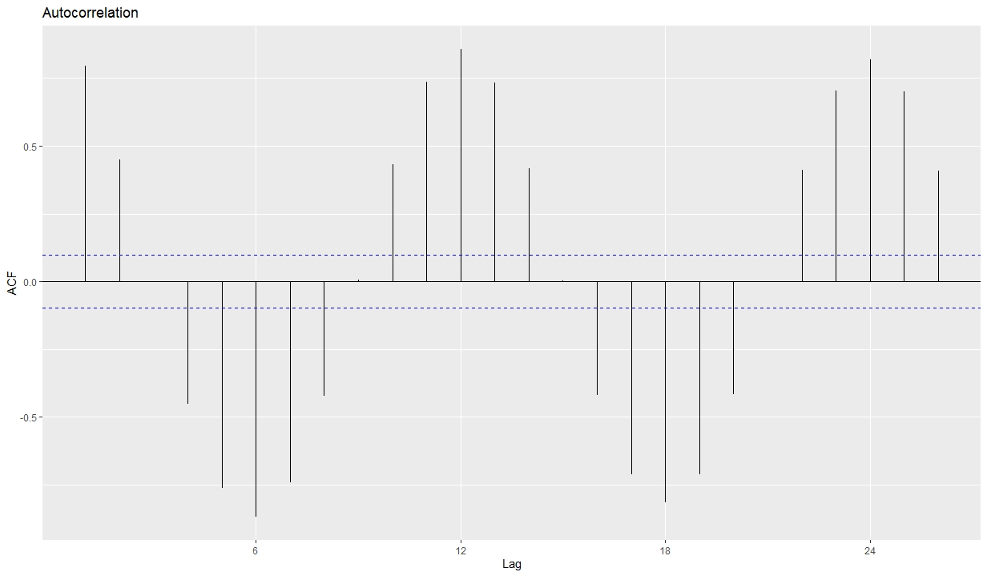
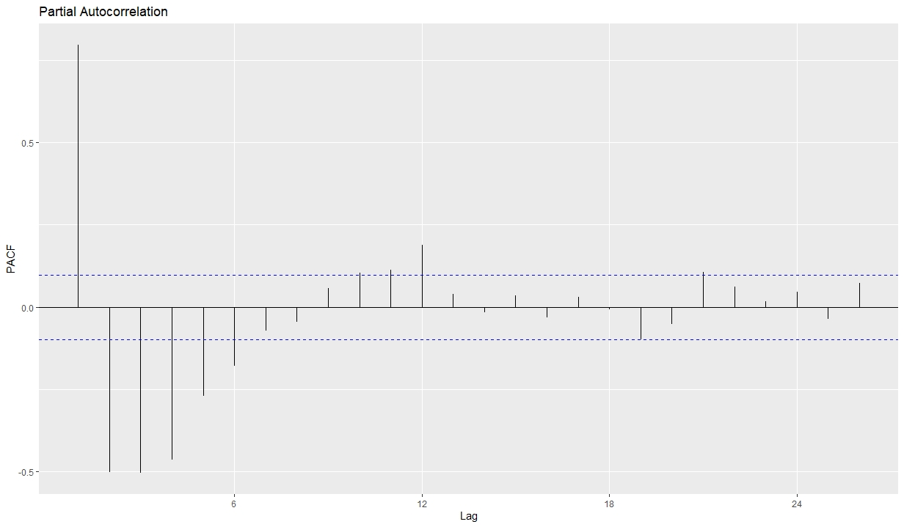
Autocorrelation
Max autocorrelation is at lag 12
Max partial autocorrelation is at lag 1
We will use an AR(1) model for further analysis

Slide 7
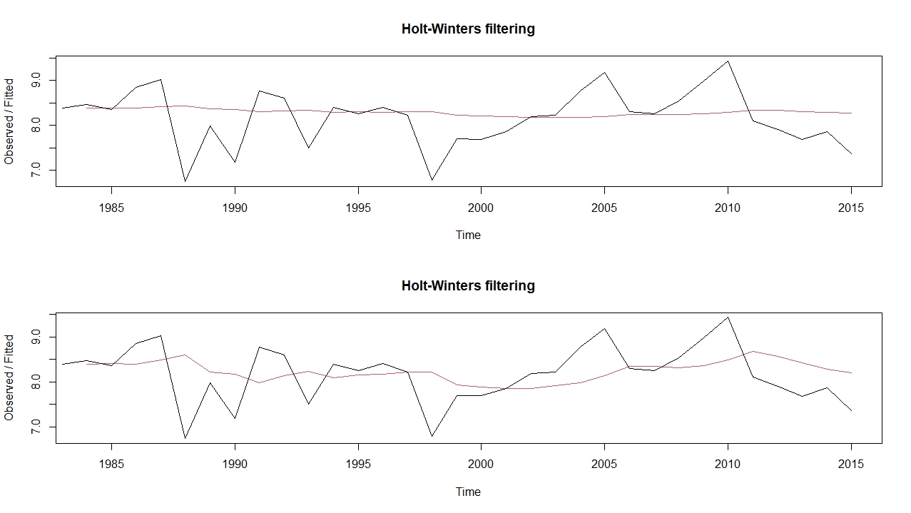
Holt Winters Smoothing
beta = F
Gamma = F
Temp = 13.828
Alpha = 0.2
beta = F
Gamma = F
Temp = 14.146

Slide 8
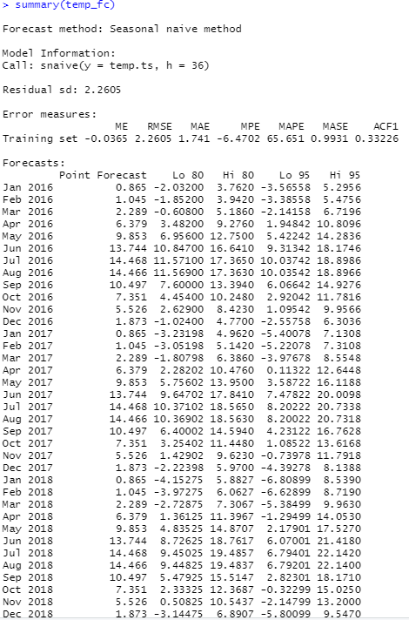
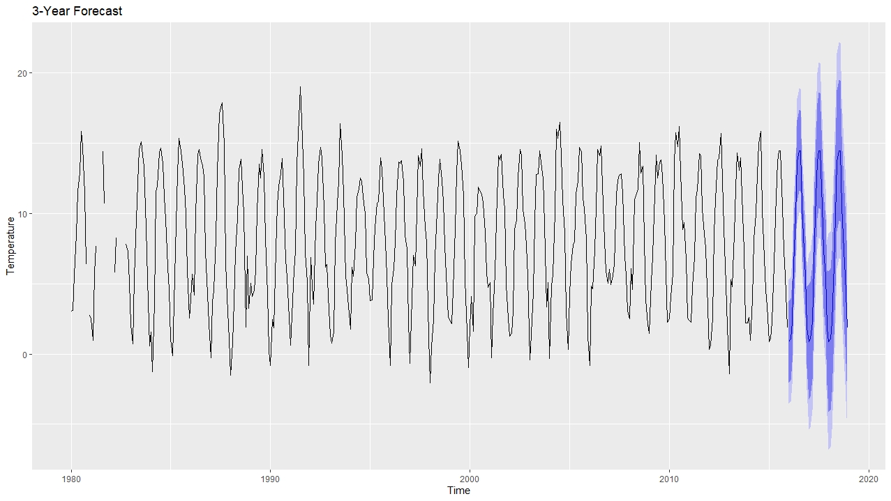
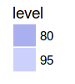
Forecasting
3- Year temperature forecast using seasonal naïve method

Slide 9
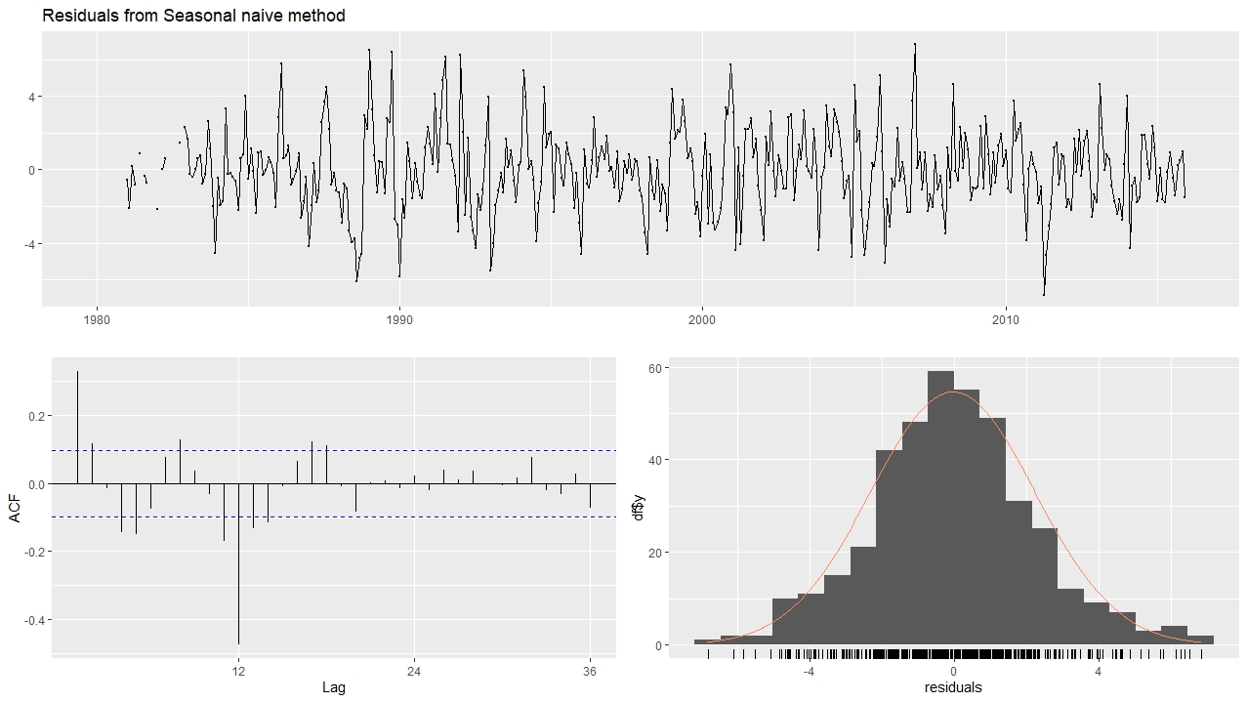
Residuals
Max autocorrelation is at lag 12

Slide 10
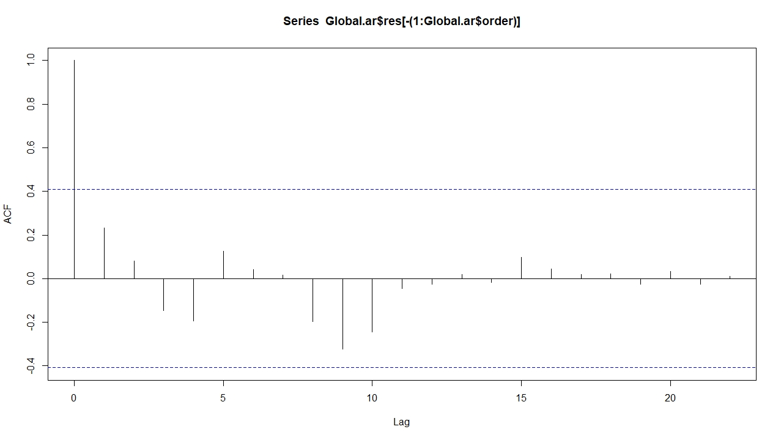
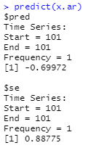
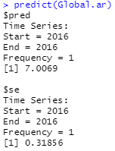
Autoregression
Fitting the simulated data to the AR(1) model, and the AR(1) model to the global temperature data.
AR(1) model prediction =
Global temp data prediction =
SA
Autoregression

Slide 11
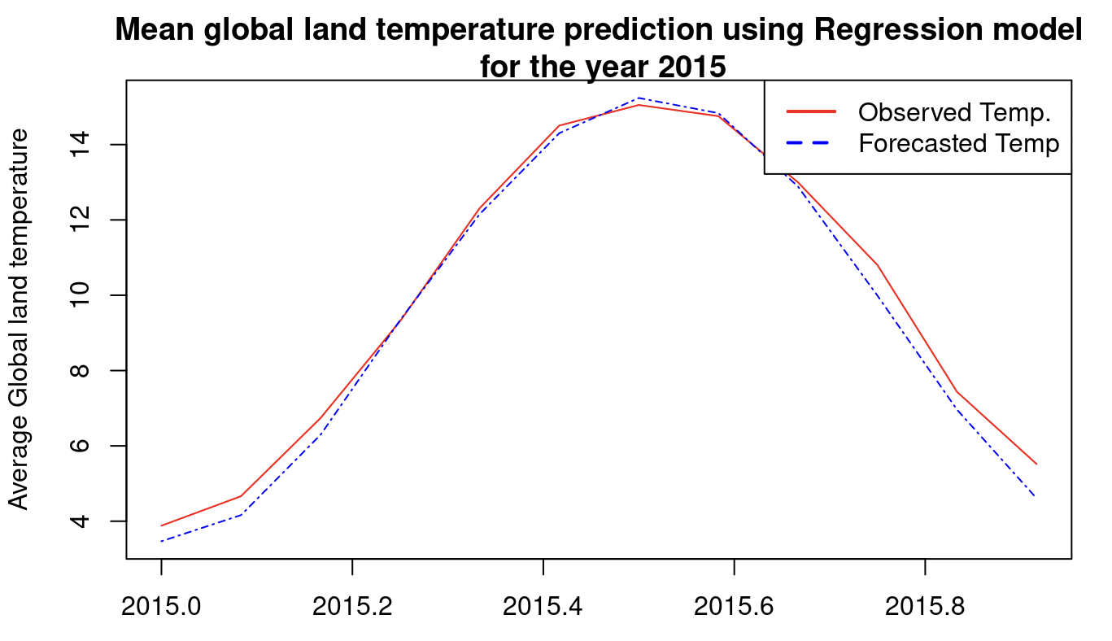
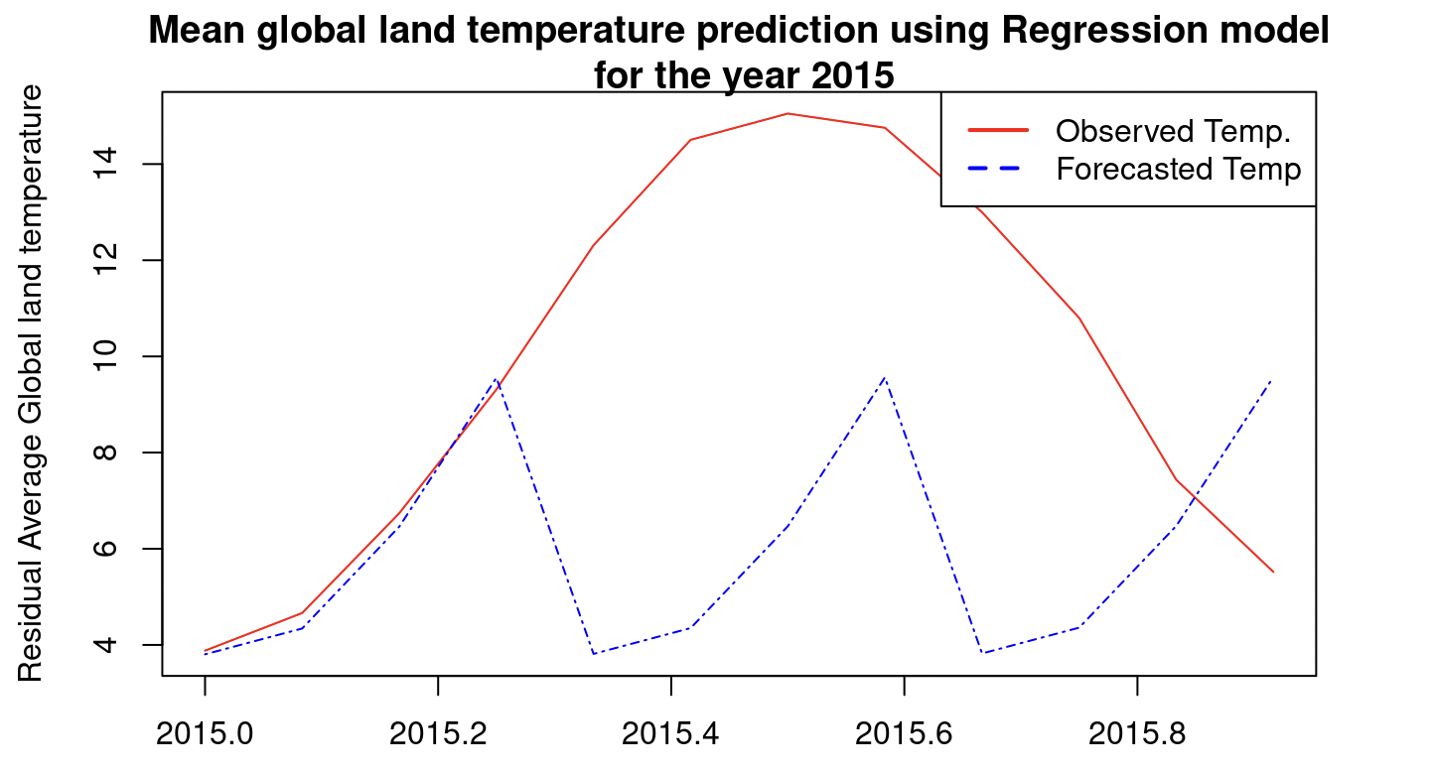
Regression Model
MAPE for this model is 5.33%
MAPE accounting residual is 30%

Slide 12
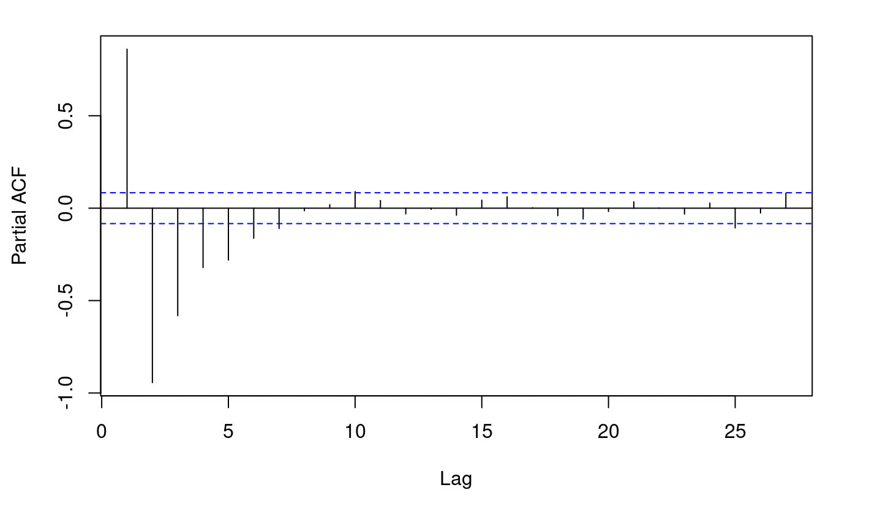
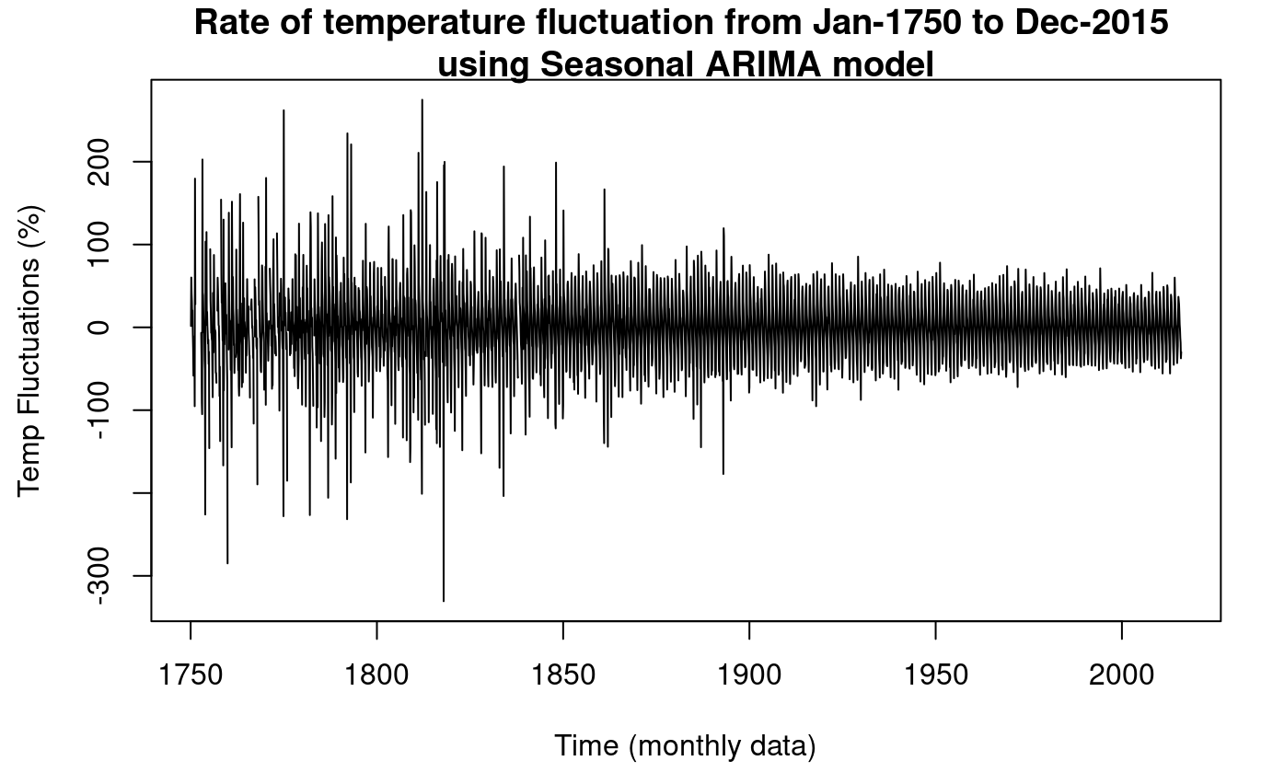
Regression Model
Regression+ ARIMA
There seems to be no auto-correlation
There has been significant changes in temp. Observed before 2000s

Slide 13
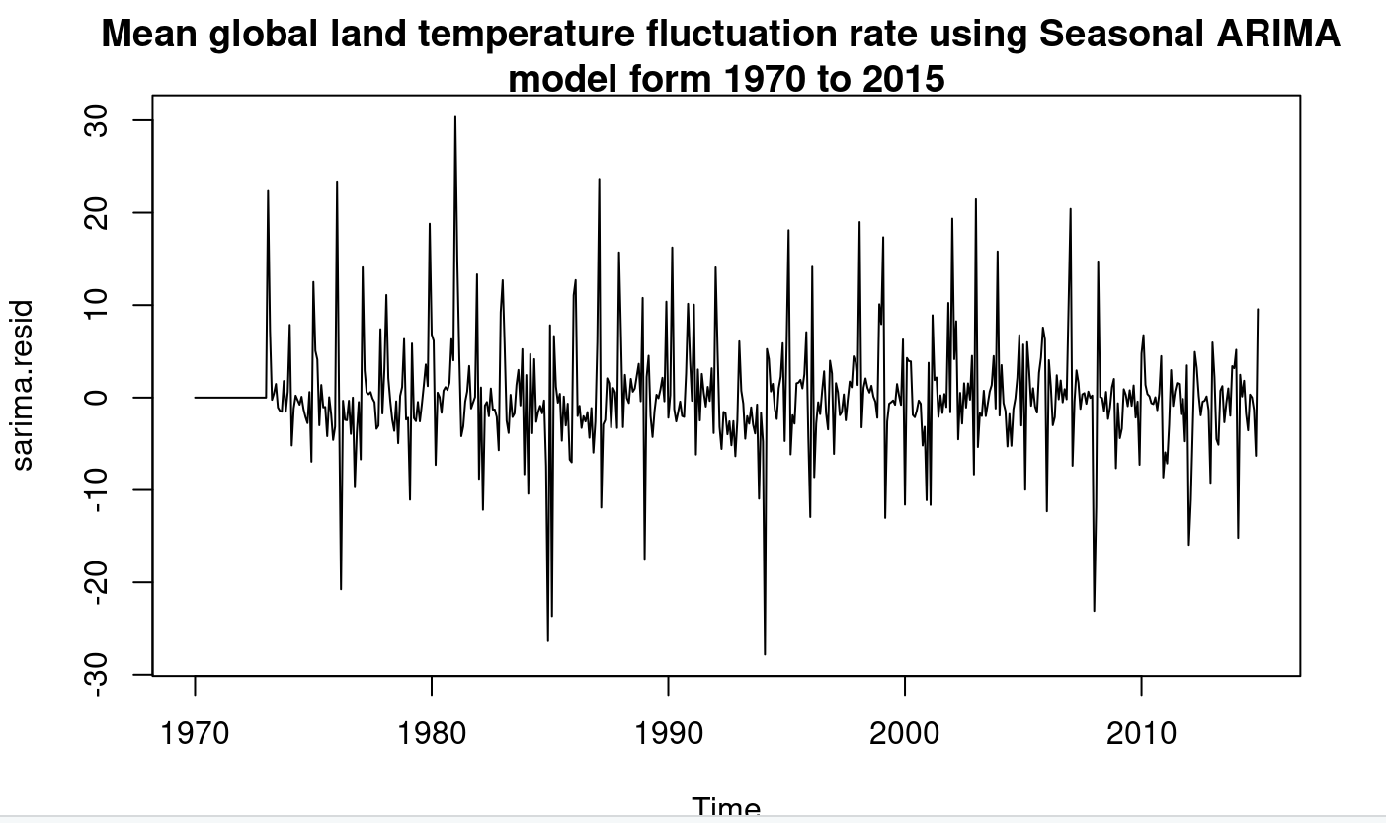
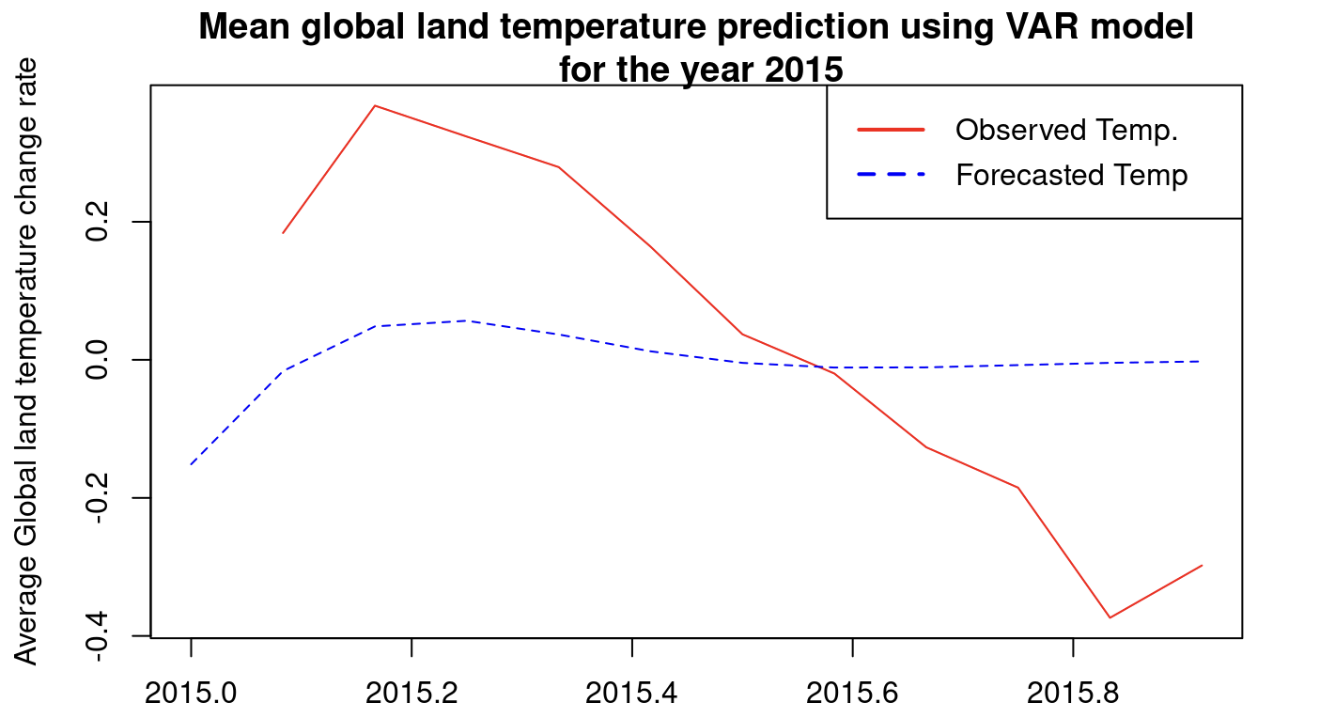
Regression+ ARIMA
Vector Auto- Regressive
Considerable change in rate of temperature fluctuations

Slide 14
Non-Seasonal ARIMA models
We want to test how our data fits with non-seasonal ARIMA models. These models include autoregressive terms, moving average terms, and differencing operations.
q: order of the moving average part;
d: degree of first differencing involved;
p: order of the autoregressive part.
From ACF and PACF plots, we decided to try out following combinations:
Q,D,P | AIC
(4, 1, 1) | 579.4807
(4, 1, 2) | 427.9056
(4, 2, 2) | 612.7501
(3, 0, 0) | 696.9034
(3, 1, 0) | 1088.121
(3, 1, 1) | 652.887

Slide 15
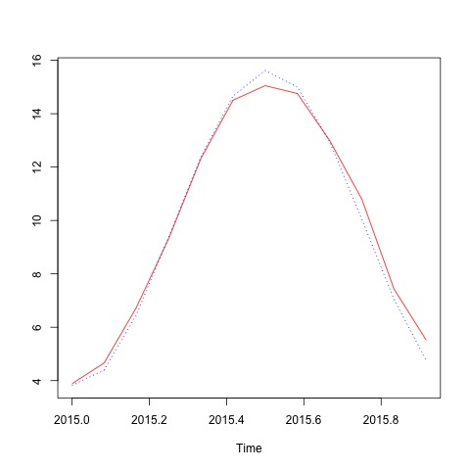
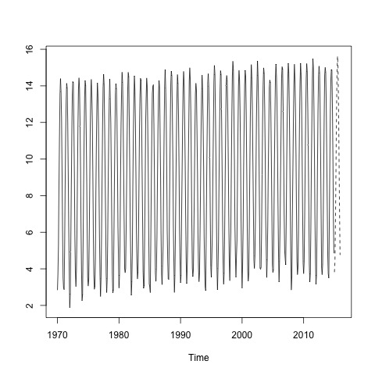
Non-Seasonal ARIMA models
landTemp.best.arima <- arima(landTempts.pre, order = c(4, 1, 2))
landTemp.arima.pred <- predict(landTemp.best.arima,12)
Mean absolute Error: 0.03784015

Slide 16
SARIMA – Seasonal ARIMA models
We then test how our data fits with seasonal ARIMA models. A seasonal ARIMA model uses differencing at a lag equal to the number of seasons (s) to remove additive seasonal effects.
q: order of the moving average part;
d: degree of first differencing involved;
p: order of the autoregressive part;
P: Seasonal autoregressive order;
D: Seasonal difference order;
Q: Seasonal moving average order;
m: The number of time steps for a single seasonal period.
We use the same function in the ANLY 565 Chapter 7 Examples.
get.best.sarima <- function(x.ts, maxord = c(1,1,1,1,1,1))
{
best.aic <- 1e8
n <- length(x.ts)
for (p in 0:maxord[1]) for(d in 0:maxord[2]) for(q in 0:maxord[3])
for (P in 0:maxord[4]) for(D in 0:maxord[5]) for(Q in 0:maxord[6])
{
fit <- arima(x.ts, order = c(p,d,q),
seas = list(order = c(P,D,Q),
frequency(x.ts)), method = "CSS")
fit.aic <- -2 * fit$loglik + (log(n) + 1) * length(fit$coef)
if (fit.aic < best.aic)
{
best.aic <- fit.aic
best.fit <- fit
best.model <- c(p,d,q,P,D,Q)
}
}
list(best.aic, best.fit, best.model)
}

Slide 17
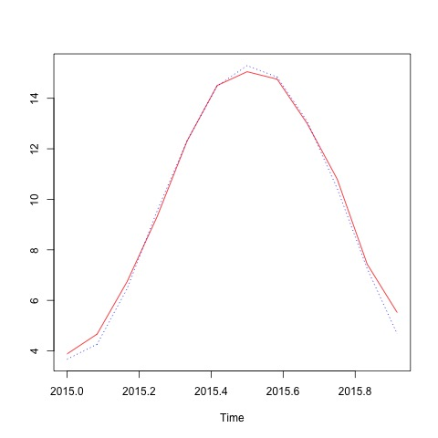

SARIMA – Seasonal ARIMA models
landTemp.best.sarima <- get.best.sarima(landTempts.pre, maxord =c(4,4,4,4,4,4))
the order of the best SARIMA model
2 1 2 2 1 2
Mean absolute Error: 0.03737912

Slide 18
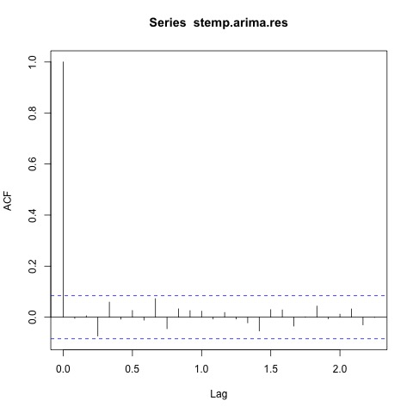
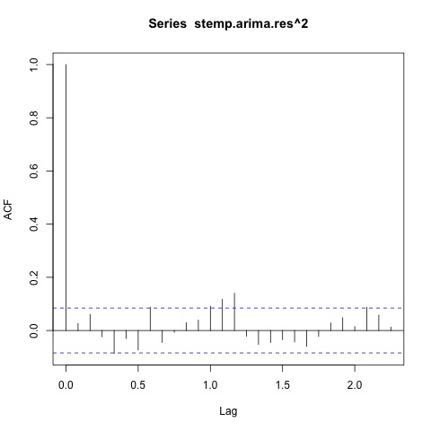
Generalized Autoregressive Conditional Heteroskedasticity - GARCH
GARCH is used when the variance error is believed to be serially autocorrelated. GARCH models assume that the variance of the error term follows an autoregressive moving average process.
We try the SARIMA + GARCH(1,1) for the temperature data.
Collect and inspect the residuals. stemp.arima.res <- resid(stemp.arima)

Slide 19
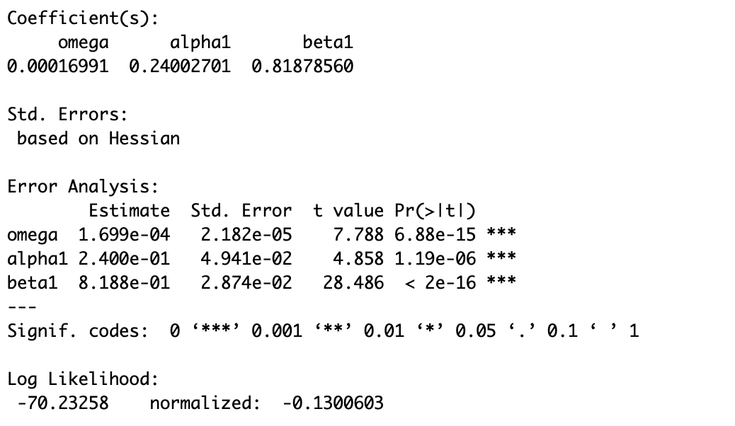
Generalized Autoregressive Conditional Heteroskedasticity - GARCH
Estimate GARCH(1,1) for the residual series.
resid.garch<-garchFit(~garch(1,1), data=stemp.arima.res,include.mean = F, trace = F)
 | meanForecast | meanError | standardDeviation
1 | 0 | 0.3563879 | 0.3563879
2 | 0 | 0.3669498 | 0.3669498
3 | 0 | 0.3778112 | 0.3778112
4 | 0 | 0.3889809 | 0.3889809
5 | 0 | 0.4004682 | 0.4004682
6 | 0 | 0.4122824 | 0.4122824
7 | 0 | 0.4244331 | 0.4244331
8 | 0 | 0.4369303 | 0.4369303
9 | 0 | 0.4497841 | 0.4497841
10 | 0 | 0.4630052 | 0.4630052
11 | 0 | 0.4766042 | 0.4766042
12 | 0 | 0.4905924 | 0.4905924

Slide 20
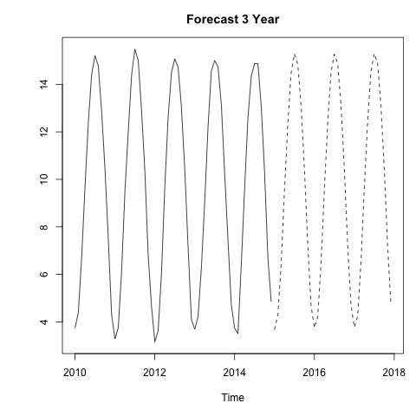
Conclusion
Which model has the best prediction accuracy than others? Which model has the least mean absolute percentage error?
Seasonal ARIMA model and non-seasonal ARIMA model have very close mean absolute percentage error. Seasonal ARIMA model is slightly better than the non-seasonal ARIMA.
What does the trend suggest for future?
Slow increase in global temperature
Year | Average
2010 | 9.703083
2011 | 9.516000
2012 | 9.507333
2013 | 9.606500
2014 | 9.570667
2015 | 9.693801
2016 | 9.713849
2017 | 9.738531

